Slide 1

CSI-317
Theory Of Computing

Slide 2
Part-I Automata Theory

Slide 3
Regular Language

Slide 4
# Contents
Introduction of GNFA?
Rules for GNFA Conversion
Convert DFA to GNFA
GNFA to Regular Expression
Self Study
GNFA Reduction

Slide 5

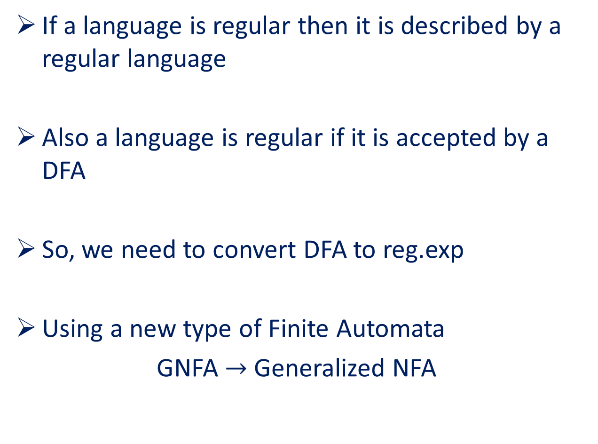
If a language is regular then it is described by a regular language
Also a language is regular if it is accepted by a DFA
So, we need to convert DFA to reg.exp
Using a new type of Finite Automata
GNFA $→$ Generalized NFA

Slide 6
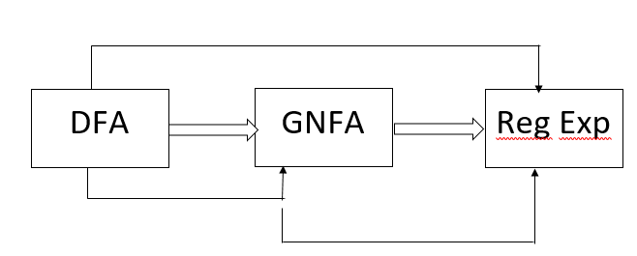
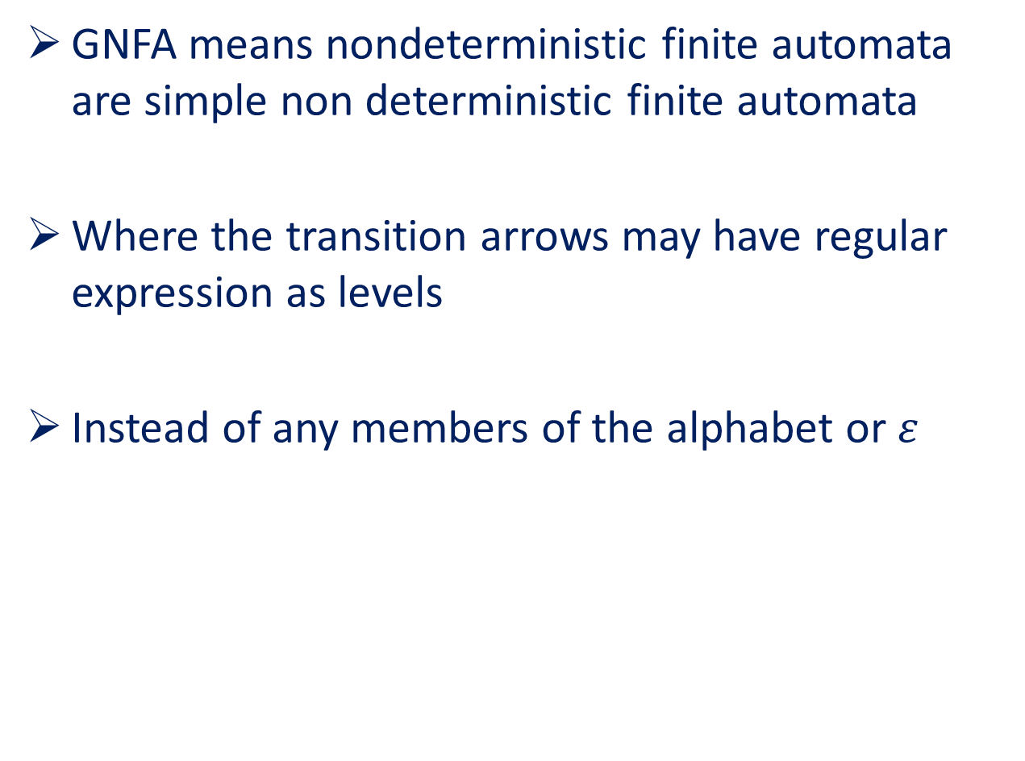
Introduction of GNFA
GNFA means nondeterministic finite automata are simple non deterministic finite automata
Where the transition arrows may have regular expression as levels
Instead of any members of the alphabet or $ε$

Slide 7
Rules for GNFA Conversion
Adding a new start and accepted state
Start state has no incoming transition
Start state has outgoing transition to every other state
There is one and only accepted state
The accepted state has no outgoing transition
Except for the start and accepted state every state has one and only outgoing transition to every other state (including itself)
The accepted state has incoming transition from every other state

Slide 8
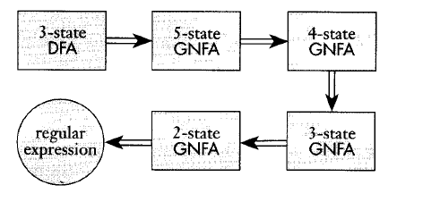
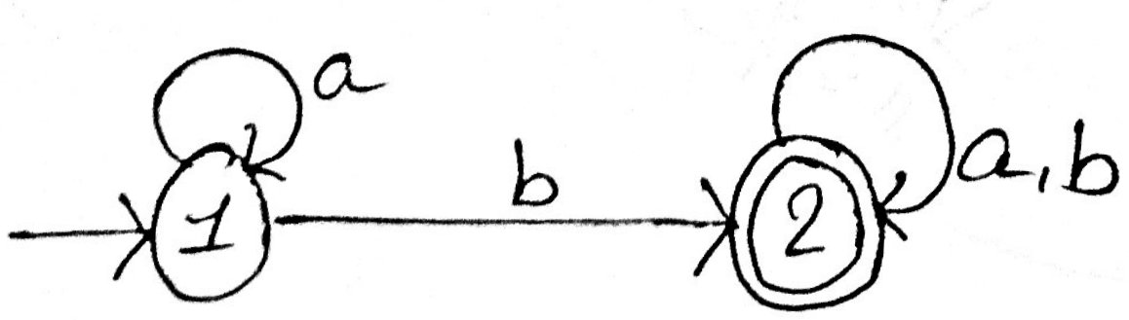
Convert DFA to GNFA
Convert the DFA to GNFA :

Slide 9
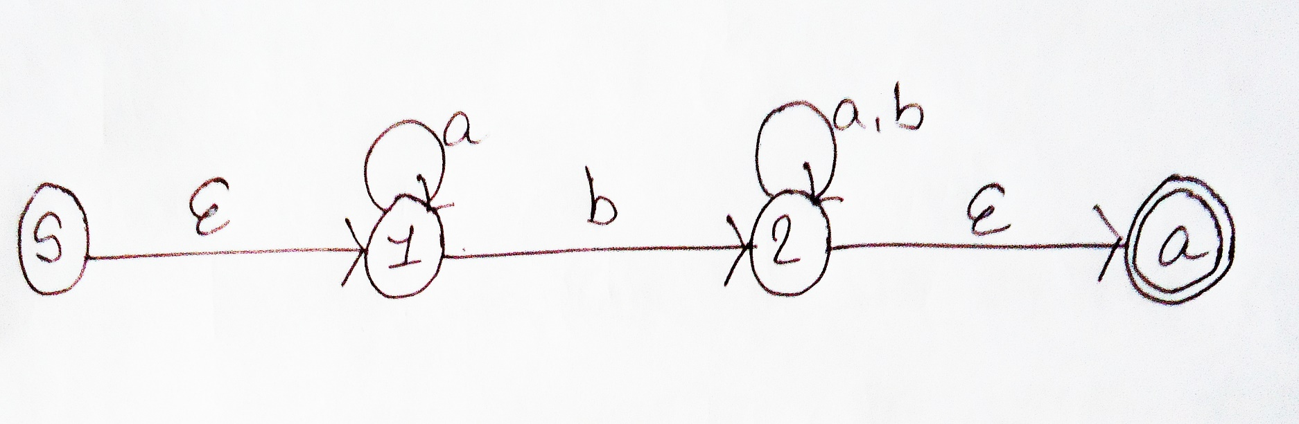
Convert DFA to GNFA (cont.)
Step 1 : adding start and accepted state

Slide 10
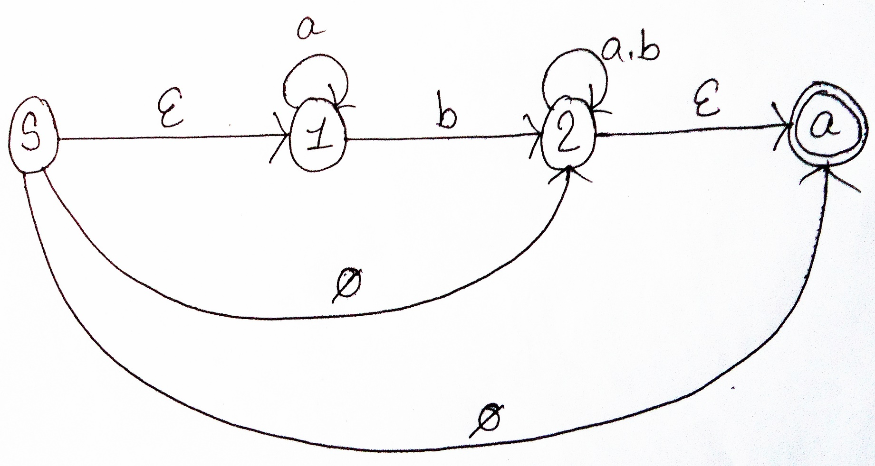
Convert DFA to GNFA (cont.)
Step 2 : Start state has outgoing transition to every other state

Slide 11
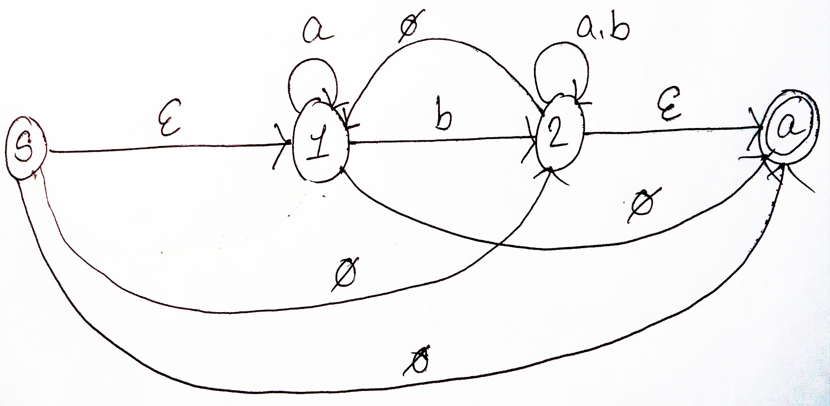
Convert DFA to GNFA (cont.)
Step 3 : Except for the start and accepted state every state has one and only outgoing transition to every other state (including itself)
GNFA

Slide 12
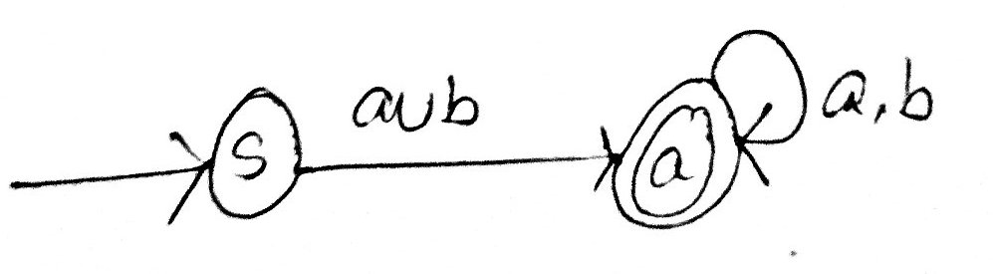
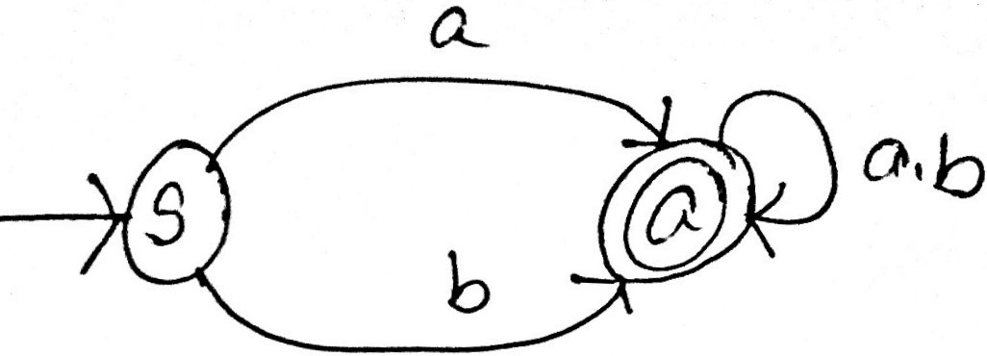
GNFA to Regular Expression
Convert the following GNFA to Reg exp
Expected Regular Expression:

Slide 13
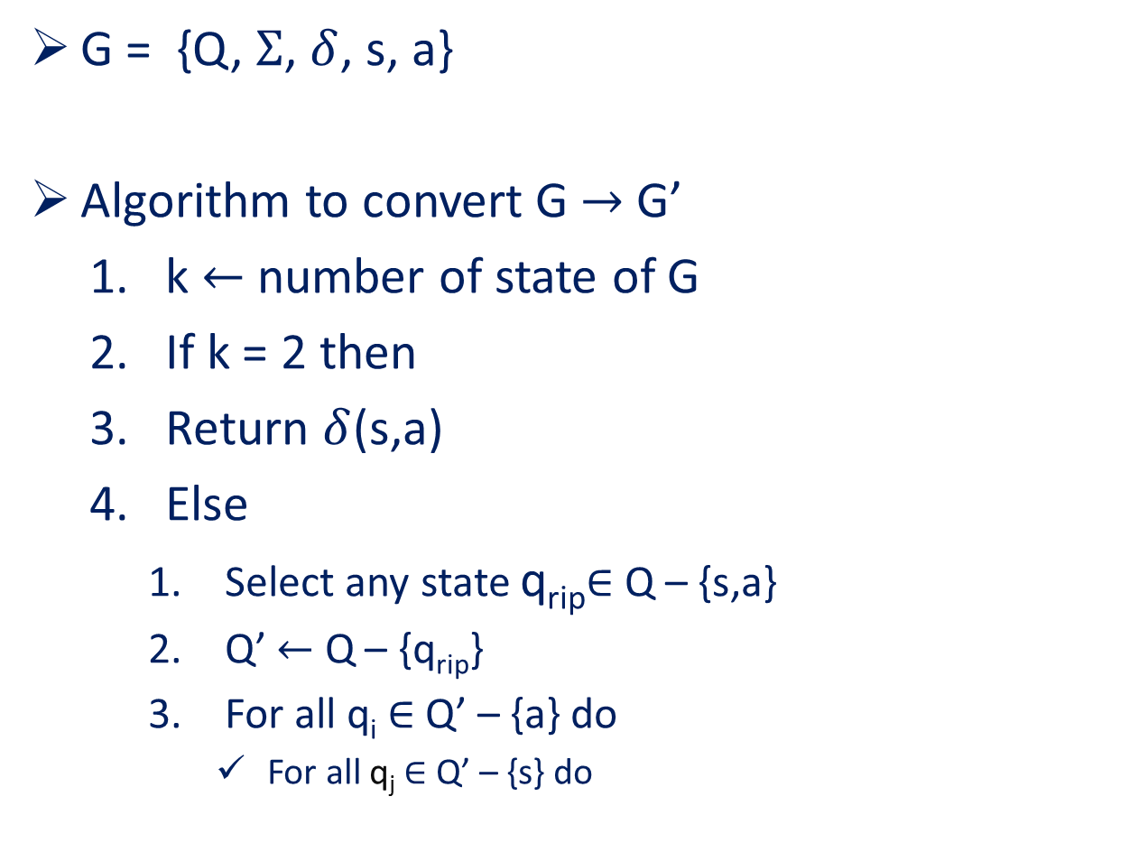
GNFA Reduction
G = {Q, $Σ$, $δ$, s, a}
Algorithm to convert G $→$ G’
k $←$ number of state of G
If k = 2 then
Return $δ$(s,a)
Else
Select any state q_{rip}$∈$ Q – {s,a}
Q’ $←$ Q – {q_{rip}}
For all q_{i} $∈$ Q’ – {a} do
For all q_{j} $∈$ Q’ – {s} do

Slide 14

GNFA Reduction (cont.)
R₁ $←$ $δ$ (q_{i}, q_{rip})
R₂ $←$ $δ$ (q_{rip}, q_{rip})
R₃ $←$ $δ$ (q_{rip}, q_{j})
R₄ $←$ $δ$ (q_{i}, q_{j})
Now $δ$‘ (q_{i}, q_{j}) $←$ [(R₁) (R₂)* (R₃)] U (R₄)
G’ $←$ (Q’, $Σ$, $δ$’, s, a)
Return convert (G’)

Slide 15
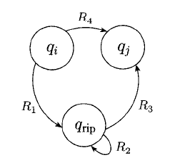
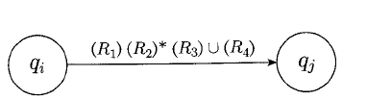
GNFA Reduction (cont.)
If GNFA is like the following figure, ten what will be the regular expression ???
Regular Expression

Slide 16
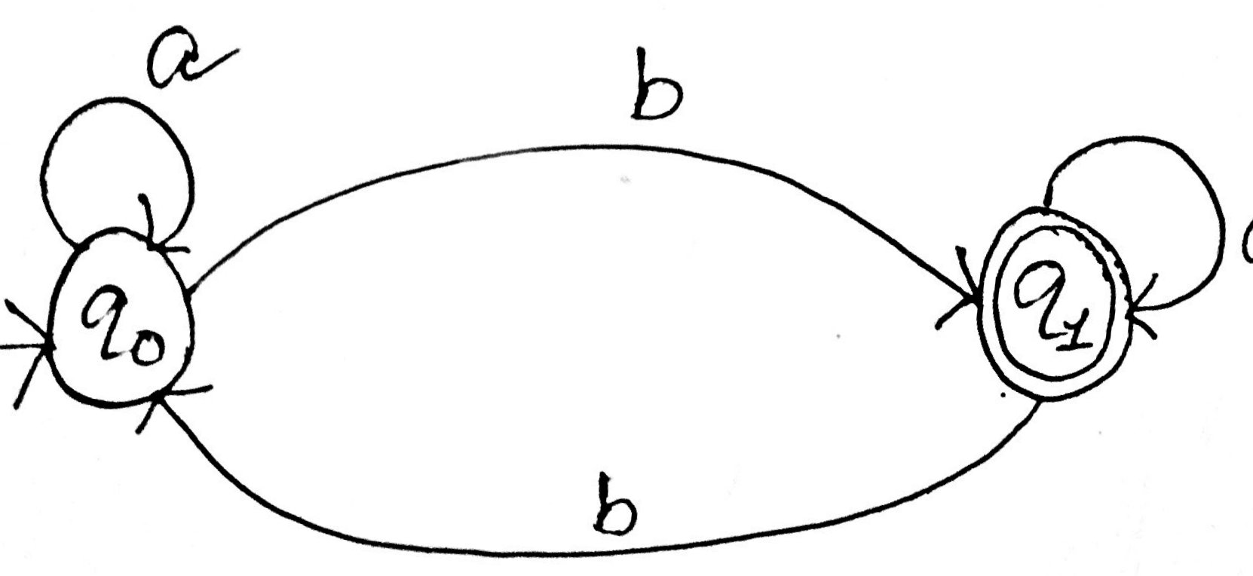
GNFA Reduction (cont.)
Convert the DFA into Regular Expression:

Slide 17
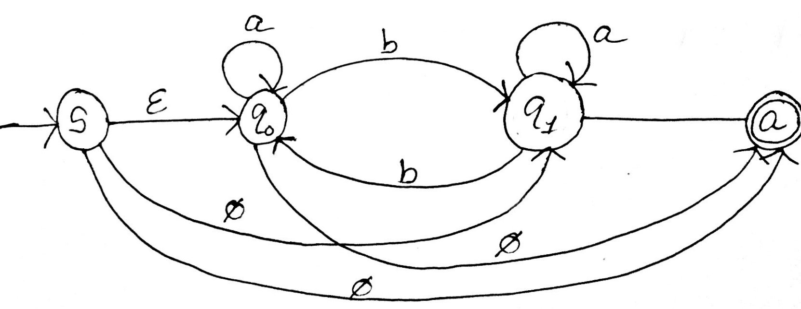
GNFA Reduction (cont.)
So, the GNFA of this DFA will be

Slide 18
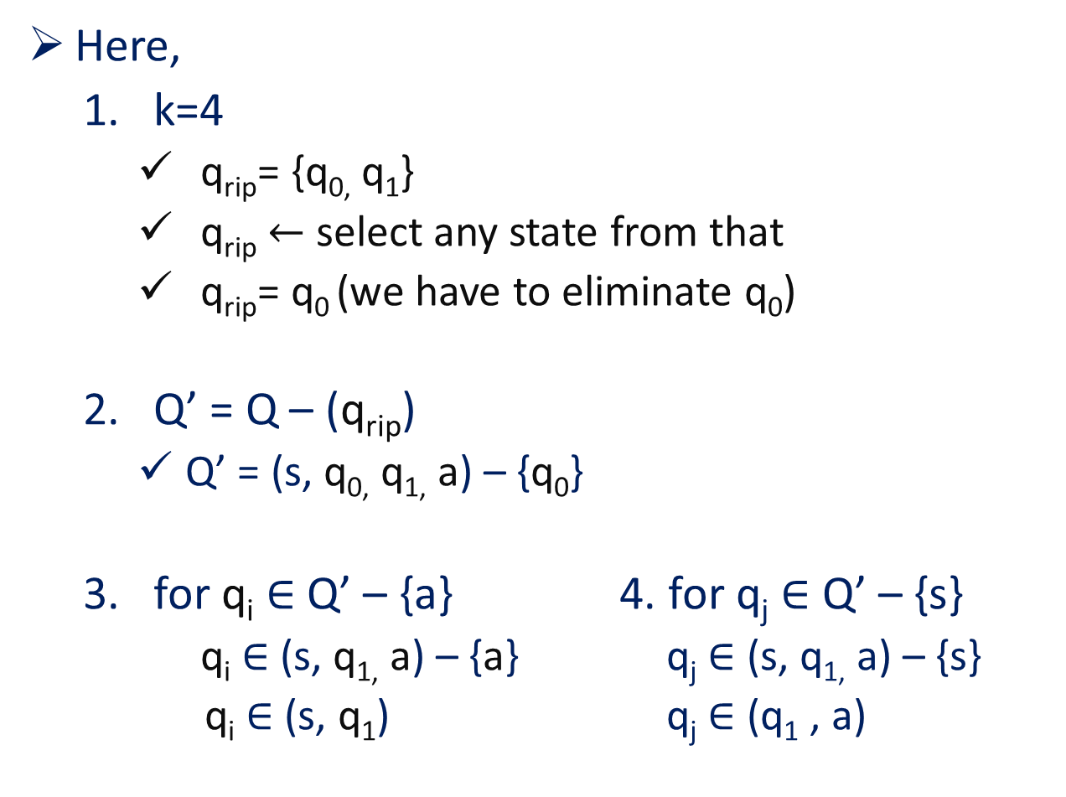
GNFA Reduction (cont.)
Here,
k=4
q_{rip}= {q_{0,} q₁}
q_{rip} $←$ select any state from that
q_{rip}= q₀ (we have to eliminate q₀)
Q’ = Q – (q_{rip})
Q’ = (s, q_{0,} q_{1,} a) – {q₀}
for q_{i} $∈$ Q’ – {a} 4. for q_{j} $∈$ Q’ – {s}
q_{i} $∈$ (s, q_{1,} a) – {a} q_{j} $∈$ (s, q_{1,} a) – {s}
q_{i} $∈$ (s, q₁) q_{j} $∈$ (q₁ , a)

Slide 19

GNFA Reduction (cont.)
Now,
Step 1:
i=1, j= 1
q_{i} =s, q_{j}= q₁, q_{rip} = q₀
R₁ $←$ $δ$ (s, q₀) = $ε$
R₂ $←$ $δ$ (q₀, q₀) = a
R₃ $←$ $δ$ (q₀, q₁) = b
R₄ $←$ $δ$ (s, q₁) = $φ$
$δ$’ (s, q₀) = ($ε$ $∙$ a* $∙$ b) U $φ$ = a*b

Slide 20

GNFA Reduction (cont.)
Step 2:
i=1, j= 2
q_{i} = s, q_{j}= a, q_{rip} = q₀
R₁ $←$ $δ$ (s, q₀) = $ε$
R₂ $←$ $δ$ (q₀, q₀) = a
R₃ $←$ $δ$ (q₀, a) = $φ$
R₄ $←$ $δ$ (s, a) = $φ$
$δ$’ (s, a) = ($ε$ $∙$ a* $∙$ $φ$) U $φ$
= $φ$ U $φ$ = $φ$

Slide 21

GNFA Reduction (cont.)
Step 3:
i=2, j= 1
q_{i} = q₁ , q_{j}= q₁, q_{rip} = q₀
R₁ $←$ $δ$ (q₁, q₀) = b
R₂ $←$ $δ$ (q₀, q₀) = a
R₃ $←$ $δ$ (q₀, q₁) = b
R₄ $←$ $δ$ (q₁, q₁) = a
$δ$’ (q₁, q₁) = (b$∙$ a* $∙$b) U a
= (ba*b) U a

Slide 22

GNFA Reduction (cont.)
Step 4:
i=2, j= 2
q_{i} = q₁ , q_{j}= a, q_{rip} = q₀
R₁ $←$ $δ$ (q₁, q₀) = b
R₂ $←$ $δ$ (q₀, q₀) = a
R₃ $←$ $δ$ (q₀, a) = $∅$
R₄ $←$ $δ$ (q₁, a) = $ε$
$δ$’ (q₁, a) = (b$∙$ a* $∙∅$) U $ε$
= $∅$ U $ε$ = $ε$

Slide 23

GNFA Reduction (cont.)
Total new transition:
$δ$’ (s, q₀) = a*b
$δ$’ (s, a) = $φ$
$δ$’ (q₁, q₁) = (ba*b) U a
$δ$’ (q₁, a) = $ε$

Slide 24
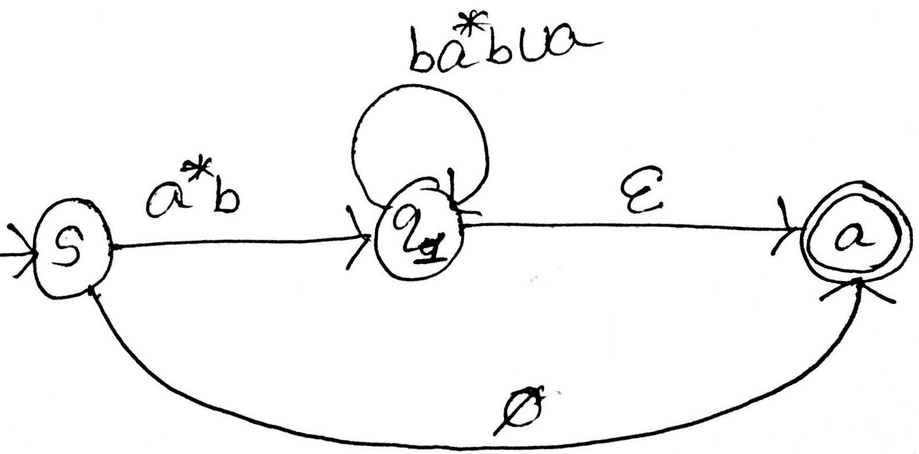
GNFA Reduction (cont.)
So the regular expression will be:

Slide 25
Self Study
Self Study : Formal Definition of GNFA
Practice
Convert the following DFA to regular expression

Slide 26
Thank You

